Slide 1


Mortimer Surgery Patient Participation Group
Presents:
HEALTH FOR THE FUTURE
How to get the most from your local surgery
Welcome!

Slide 2

Mortimer Surgery Patient Participation Group Presents:
HEALTH FOR THE FUTURE
How to get the most from your local surgery
PROGRAMME
Displays BY SUPPORT ORGANISATIONS:- AGE UK BERKSHIRE, DEMENTIA CONNECT, TIME TO TALK, WEST BERKSHIRE COST OFLIVING HUB, CALCOT EAST FAMILY HUB
Wednesday 7th June 2023, 6.30 – 8.30pm , St John’s Hall, Mortimer RG7 3TF
6.15 pm | Doors open
18.30 | Introduction and Welcome | Shirley Cullup, Chair, Mortimer Patient Participation Group
18.40 | Mortimer Surgery – How We Can Help You Now and into the Future | Dr. Iain Rock, Senior Partner
19.15 | The role of the Paramedics | Gemma Longmate
19.25 | The role of the Social Prescriber | Sarah Morland
19.35 | Managing the Practice | Penny Palmer
19.45 | Panel Q&A
20.00 | Close and time to visit support organisation stands
20.20 | Empty hall
20.30 | Lock up

Slide 3
Health For the Future
Dr Iain Rock

Slide 4
Welcome and Thank You

Slide 5
Staff
Doctors
Nurses
Allied
    Physio
    Pharmacy
    Paramedics
    Social Prescriber

Slide 6
Quality Control And Performance Indicators
Quality Outcomes Framework
Investment and Impact Fund
Patient Survey
Friends and Family
Appointments per 1000 Patients
Prescribing
Community Pharmacy Consultation Scheme

Slide 7
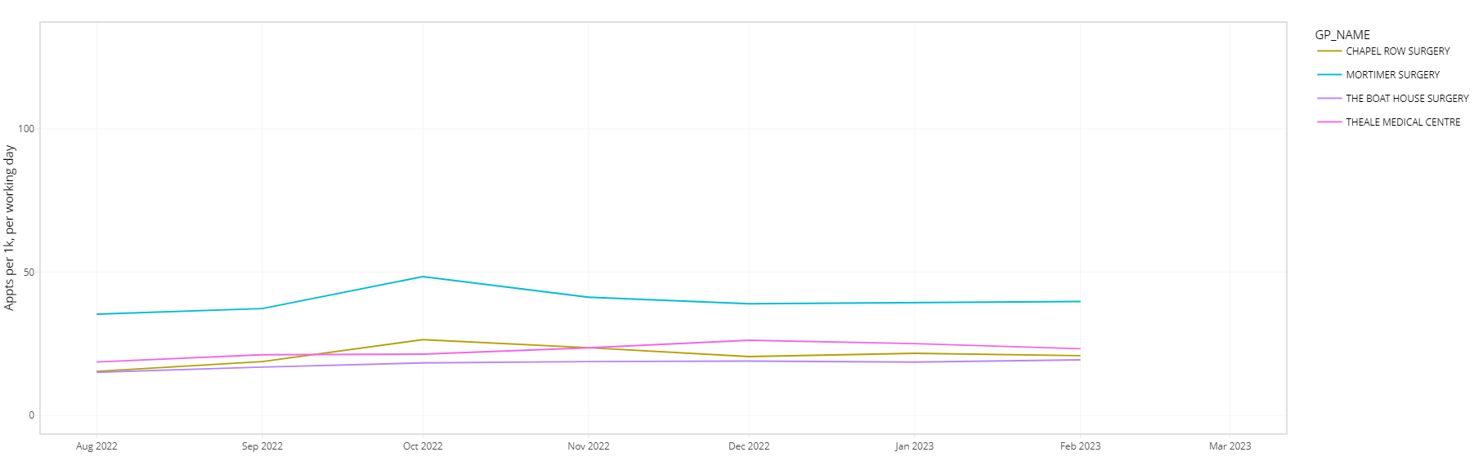
Appointment data

Slide 8
PCN – Primary Care Network
ICB – Integrated Care Board
Medication Reviews and Chronic Disease Management
Immunisation Programme
    Covid
    Flu

Slide 9
Medicine Supplies
Alternative Site For the Surgery
Training Environment
Information Technology
  Apps
  AccuRX
  Phone System

Slide 10
Mortimer Surgery
Health for the Future

Slide 11
Primary Care Network
PCNs across England are based on GP registered patient lists, typically serving natural communities of between 30,000 to 50,000 people. They are small enough to provide the personal care valued by both people and GPs, but large enough to have impact and economies of scale through better collaboration between GP practices and others in the local health and social care system.
PCNs are led by clinical directors who may be a GP, general practice nurse, clinical pharmacist or other clinical profession working in general practice. Ours is Dr Jimmy Lennox based at Chapel Row.
Our PCN is West Reading Villages and we work with Pangbourne, Theale and Chapel Row to provide a number of services across the area which totals 42901 patients. Our biggest project was the first covid vaccinations delivered at Pangbourne, which are still organised through Pangbourne but we deliver at our own surgeries now.
We also offer an Enhanced Access provision so that patients from across the area have the opportunity to see a clinician between 8am and 8pm Monday to Friday and Saturday morning. We take it in turns to offer appointments in the evening, our evening is Tuesday and then every 4th Friday and Saturday.

Slide 12
Primary Care Network
Tackling Neighbourhood Health Inequalities
Enhanced Access
Early Cancer Diagnosis
Structured Medication review
Enhanced Health In Care Homes
Investment and Impact Fund
Additional Capacity
Cardiovascular Disease Prevention and Diagnosis
Social Prescribing Service

Slide 13
Impact and Investment Fund
For the year 2022-23 there were 32 indicators that we had to report on, ranging from number of flu vaccines administered, monitoring of patients with Hypertension, High Cholesterol, Cardiovascular Disease, Asthma, Care Home Residents, those prescribed Anti-coagulants, Asprin, Exoxaban, Non-steroidal anti-inflammatory drugs etc. Referrals to Social Prescribing, CPCS, 2WW Cancer referrals, Specialist Advice. All with targets around 80-90%
This year these have been reduced to 4 indicators to concentrate on a Capacity and Access Improvement Plan to increase appointment availability within two weeks of booking.
The 4 indicators are Flu Vaccinations to 18-64 years At Risk and aged 2-3 years, Tackling Health Inequalities - Learning Disability Health Checks, Cancer 2 Week Wait Referrals and finally the percentage of appointments where time from booking to appointment is two weeks or less.
Over the last 12 months we booked 93350 appointments of which 60563 were with a doctor, 14620 with a nurse, 2738 with a paramedic, 2508 flu appointments and 1834 Physio. We average 77% of appointments within 2 weeks and 48% on the day appointments. This includes Face to Face, telephone calls, home visits and care home ward rounds. The remainder are Clinical Pharmacy, Social Prescriber and AAA clinics.

Slide 14
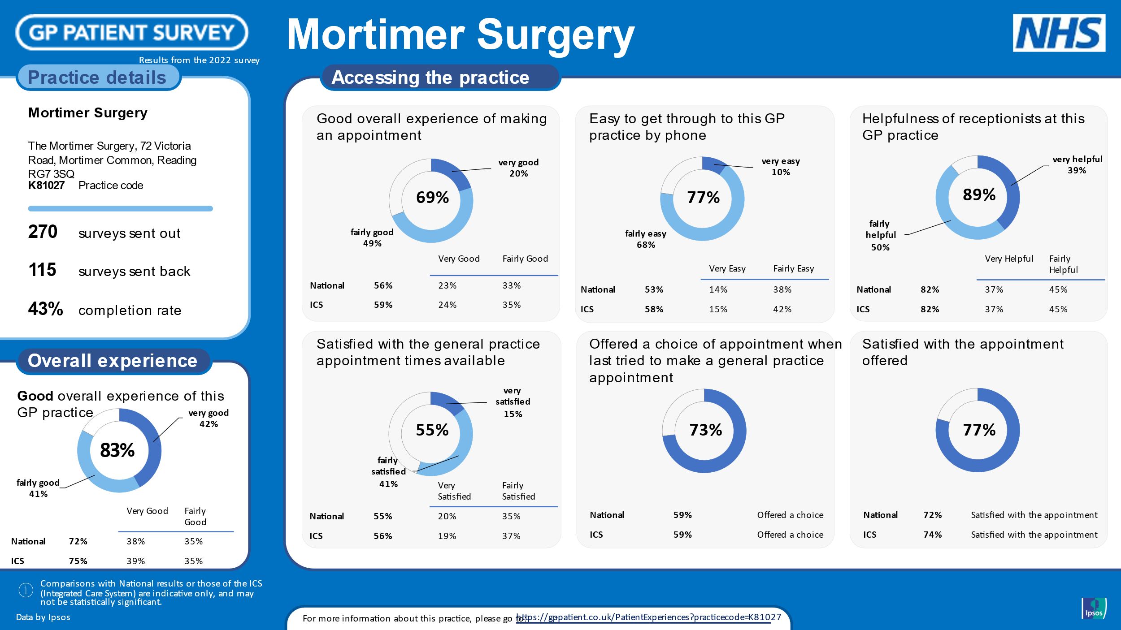
Patient Survey - 2022

Slide 15
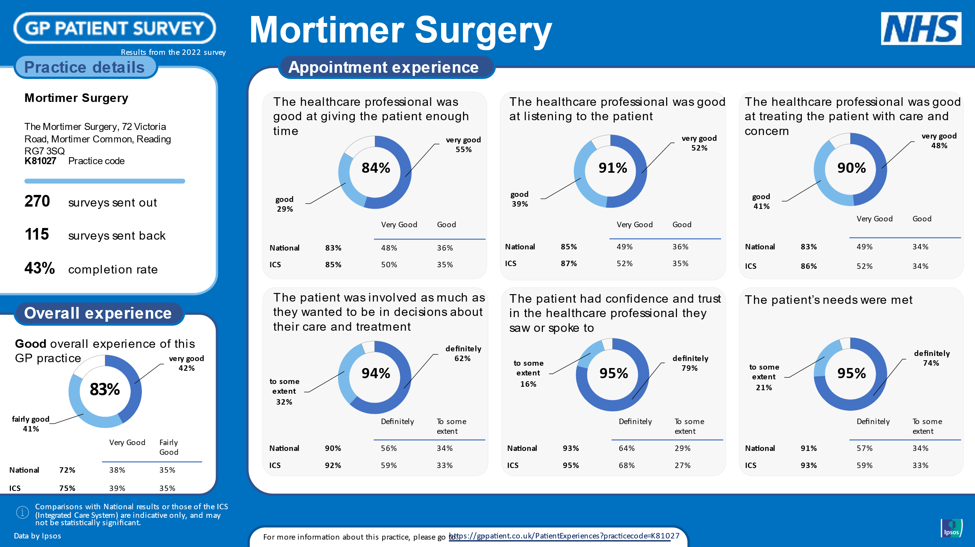
Patient Survey - 2022

Slide 16
Quality Outcomes Framework
Group Name | Achieved Points | Maximum Points | No. Patients | % to Achieve
Atrial fibrillation | 29.00 | 29.00 | 265 | 70%-95%
Asthma | 45.00 | 45.00 | 745 | 45%-80%
Cancer | 13.00 | 13.00 | 463 | 70%-90%
Secondary prevention of coronary heart disease | 28.00 | 28.00 | 317 | 56%-96%
Chronic kidney disease | 6.00 | 6.00 | 531 | N/A
Chronic obstructive pulmonary disease | 19.00 | 19.00 | 205 | 50%-90%
Dementia | 44.00 | 44.00 | 98 | 35%-70%
Depression | 10.00 | 10.00 | 866 | 45%-80%
Diabetes mellitus | 67.00 | 67.00 | 534 | 50%-90%
Epilepsy | 1.00 | 1.00 | 73 | N/A
Heart failure | 29.00 | 29.00 | 79 | 60%-92%
Hypertension | 25.00 | 25.00 | 1939 | 40%-80%
Learning Disability | 4.00 | 4.00 | 34 | N/A
Mental health | 38.00 | 38.00 | 70 | 40%-90%
Non-diabetic hyperglycaemia | 18.00 | 18.00 | 536 | 50%-90%
Osteoporosis: secondary prevention of fragility fractures | 3.00 | 3.00 | 72 | N/A
Peripheral arterial disease | 2.00 | 2.00 | 46 | N/A
Palliative care | 3.00 | 3.00 | 36 | N/A
Rheumatoid arthritis | 6.00 | 6.00 | 69 | 40%-90%
Stroke and transient ischaemic attack | 11.00 | 11.00 | 216 | 57%-97%
Clinical domain | 401.00 | 401.00 | 4668

Slide 17
Quality Outcomes Framework
Group Name |  |  | Achieved Points | Maximum Points | No.of Patients | % to Achieve
Blood pressure |  |  | 15.00 | 15.00 | 4844 | 50%-90%
Obesity |  |  | 8.00 | 8.00 | 561 | N/A
Smoking |  |  | 62.00 | 62.00 | 9301 | 56%-96%
Public health domain: All contracts |  |  | 85.00 | 85.00 | 14706
Group Name |  |  | Achieved Points | Maximum Points | No.of Patients | % to Achieve
Cervical screening |  |  | 11.00 | 11.00 | 2842 | 45%-80%
Public health domain: Additional services sub domain |  |  | 11.00 | 11.00 | 2842
Group Name |  |  | Achieved Points | Maximum Points | No.of Patients | % to Achieve
Vaccination and Immunisation |  |  | 63.05 | 64.00
Pts Aged 8 months Dip/Tet/Pert |  |  |  |  | 73 | 90%-95%
Pts Aged 18 months - MMR |  |  |  |  | 97 | 90%-95%
Pts Aged 5years - DTaP/IPV/MMR |  |  |  |  | 111 | 90%-95%
Pts Aged 80-81 - Shingles Vaccine |  |  |  |  | 165 | 50%-60%
Public health domain: Vaccination and Immunisation sub domain |  |  | 63.05 | 64.00 | 446
 | Our Achievement |  | 560.05 | 561.00

Slide 18
Friends and Family
Friends and Family is a patient survey that is sent out after appointments and also available in the surgery to collect patient responses to two questions.
1. How likely are you to recommend our GP practice to friends and family if they need similar care or treatment?
2. Which service do we provide that you most value?
Over the last 4 months we have received 279 responses, of which 95% were extremely likely to recommend our service which we are very pleased about. Although one negative reply was because if we were recommended, it would increase our patient numbers which might reduce our excellent service!

Slide 19
Enhanced Services
Enhanced services are services provided by GPs, over and above the core (essential and additional) services to their patients. The aim of Enhanced Services is to meet the needs of the local population, recognising and addressing gaps in the core services in order to reduce the necessity for admission to secondary care.
The Enhanced services that we offer over and above the services detailed above in Qof, IIF and the PCN Enhanced Service are as follows:
Minor Ops
Heart Failure reviews
Denosumab Administration
ADHD Reviews and Monitoring
Contraception
Phlebotomy
Zoladex Administration
Insulin Conversions
Pre Diabetes Checks
First Check for New born Babies
DMARDS/Near Patient Testing for those not monitored on DAWN
Rheumatology Pts in remission
Enhanced Physical Health Checks
NHS Health Checks
All Vaccinations
Learning Difficulty Healthchecks
Long Covid monitoring
Weight Management
Ukranian Health
Oximetry at Home
Quality Improvement Initiatives

Slide 20
Prescribing Quality Scheme
No. | Quality Targets | Measurement of Target | Points
1 | Hypertension – The practice should review patients on the hypertension register, with a BP >140/90mmHg, | Submission of anonymised data collection sheets showing clinical interventions where appropriate, returned to MOT | 20
2 | Lipid Management – The practice should review patients aged < 80 years who are prescribed a suboptimal Statin for Secondary prevention of cardiovascular disease. | Submission of anonymised data collection sheets showing clinical interventions where appropriate, returned to MOT | 20
3 | Antimicrobial Stewardship Audit – The practice will undertake an audit of the prescribing of 4Cs (Co-amoxiclav, Cephalosporins, Clindamycin and Quinolones). | Submission of anonymised audit, action plan and discussion documents to MOT | 10
No. | Safety Target | Measurement of Target | Points
4 | Gastro-protection (All sections to be completed to be awarded the points) | Submission of anonymised data collection sheets showing clinical interventions where appropriate, returned to MOT | 15
 | a) The practice should review all patients aged 65 and over prescribed an oral NSAID in the last 6 months, who do not have any gastro-protection prescribed.
 | b) The practice should review all patients prescribed an oral anticoagulant plus an anti-platelet, who do not have any gastro-protection prescribed.
 | c) The practice should review all patients prescribed aspirin plus an anti-platelet, who do not have any gastro-protection prescribed.

Slide 21
Dispensing Quality Scheme
This scheme is based on the Dispensary department. It reviews evidence on the Governance of dispensary services including Standard Operating Procedures, Clinical Audits, Significant Events, Dispensing Reviews of Use of Medicines, Staff Qualifications, hours and Staff Competencies and recent training.
We need to complete at least 10% of medicine reviews on our dispensing patients which totals 160 each year.
We also need to supply evidence of audits completed on various aspects of the dispensary service such as Prescription Instructions or the quality and advice offered to patients.

Slide 22
Information Technology
Patient Online Services – Owned and run by Vision – our Clinical System. 7221 patients have signed up to this. Patients have to supply identification to the surgery to be allowed access to their records for GDPR purposes.
GP App – Run by Iplato – links through Vision but recent problems make this a less sustainable option.
NHS App – Run by the NHS and links to both our clinical system and secondary care therefore shows a complete picture of a patients medical care. Patients need to be signed up to Patient Services for the medical records to link to the NHS App.
All three give the options of booking appointments, ordering medication and viewing medical records.

Slide 23
Further Advances in IT
We have a new telephone system, recently installed and gives us the options to log the number of calls, inbound and outbound, by department, or staff member. We can record calls, offer patient callback, number in the queue and voicemail options. It shows us how many calls are queuing and the time the call has been waiting. Since we went live on 24th March there have been 18,067 inbound telephone calls through reception alone and 594 patients have used the call back service.
Hopefully with more data we can improve our service during busy times and keep patients more informed. We are still learning about the system but have been very happy so far.
We are also using online technology such as AccuRX which allows us to send batch messages to patients, for example for BP readings, invites to clinics and information updates and allows patients to book for clinic such as the covid clinics where we used it extensively. It is also available for the clinicians to contact patients directly to send messages and attachments such as sick notes, blood forms, referral letters and patient advice leaflets. It saves any direct communication to the patient notes including any images sent by the patient for consultations and finally it offers the ability for video consultations.

Slide 24
Community Pharmacy Consultation Service
Launched by the NHS to facilitate patients having a same day appointment with their community pharmacist for minor illness or an urgent supply of a regular medicine, improving access to services and providing more convenient treatment closer to patients’ homes.
The service is helping to alleviate pressure on GP appointments and emergency departments, in addition to harnessing the skills and medicines knowledge of pharmacists. Should the patient need to be escalated or referred to an alternative service, the pharmacist can arrange this.
The practice, urgent or emergency care navigator, triage nurse or NHS 111 call advisor makes a digital referral to a convenient pharmacy, where the patient will receive pharmacist advice and treatment for a range of minor illnesses, or for an urgent supply of a previously prescribed medicine.
Our reception staff will offer the opportunity of a pharmacy appointment and will ask a series of questions from a referral website to ascertain the suitability of the illness and book the appointment to a pharmacy of the patient choice.

Slide 25
Care Quality Commission
The CQC is the independent regulator of Health and Social Care and monitors and scores Practices against 5 criteria, Safe, Effective, Caring, Responsive and Well-led.
We were last inspected on 3rd Dec 2019 but have had recent communications with the CQC. They regularly review our data such as our QoF achievements, IIF results, our website, complaints, Friends and Family results, our data supplied to NHS England and the Integrated Care Board through sites such as Connected Care and GPAD which include appointments numbers, staff, patient numbers and extra services we supply as well as our Infection Control inspections.
We are pleased to say that they are happy with the way we are working and have no intension of instigating an inspection in the near future.

Slide 26
Mortimer Surgery Patient Participation Group
Presents:
HEALTH FOR THE FUTURE
How to get the most from your local surgery
Thank You!
ppgmortimersurgery@gmail.com

